Slide 1
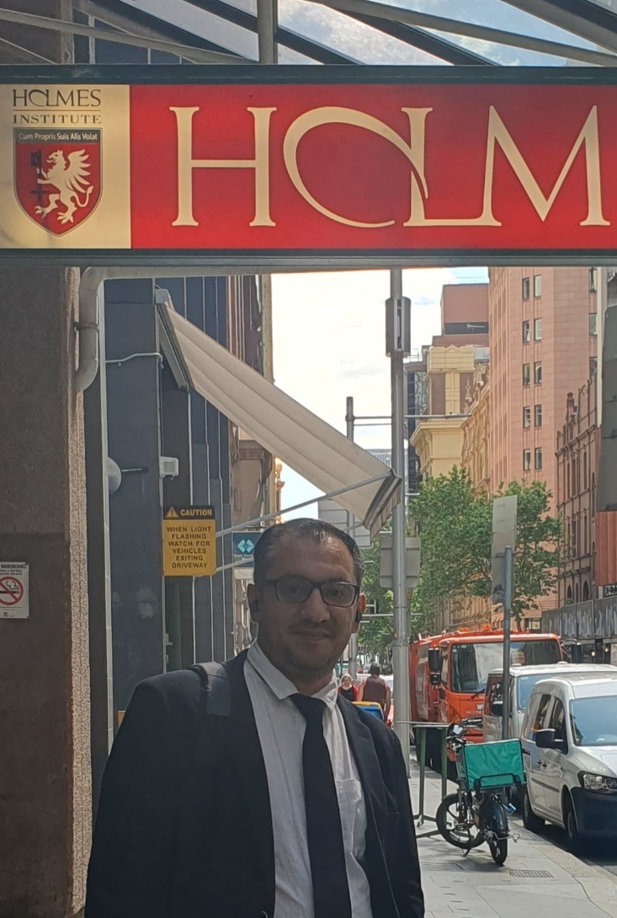

HS1021: Web Design
Weeks 8 – 9 Tutorial and Lab 4 Test Practice
Dr. Farshid Keivanian

Slide 2

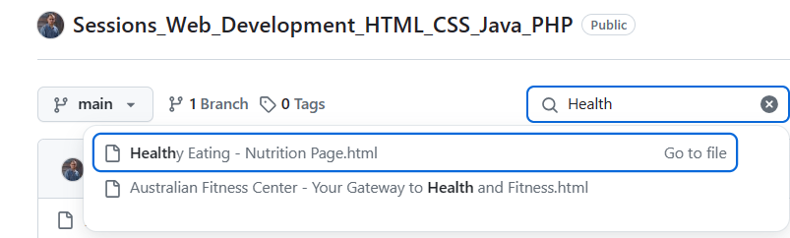
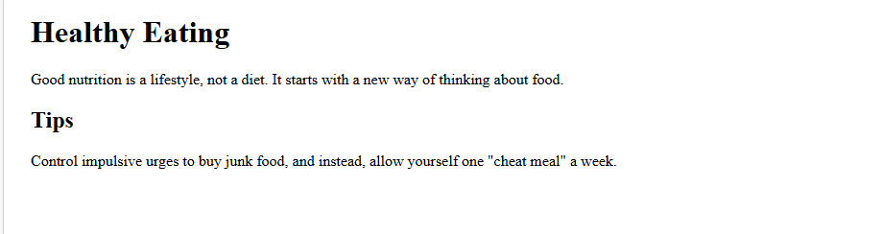
Weeks 8 – 9 Tutorial: Explicit example 1 covering lecture 7
These HTML and CSS codes work together to create a simple, responsive webpage with a main article and an aside for additional tips, while ensuring that images are fluid and adapt to the container's width.
HTML and CSS Code:

Slide 3
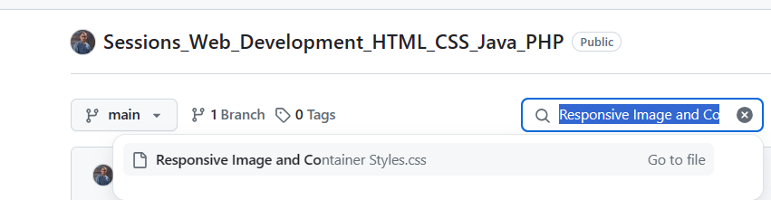
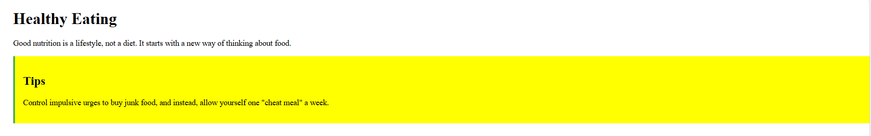
Weeks 8 – 9 Tutorial: Explicit example 1 covering lecture 7
Add aside element in the css file
aside {
background-color: yellow;
padding: 1em;
border-left: 4px solid #4CAF50;
}

Slide 4
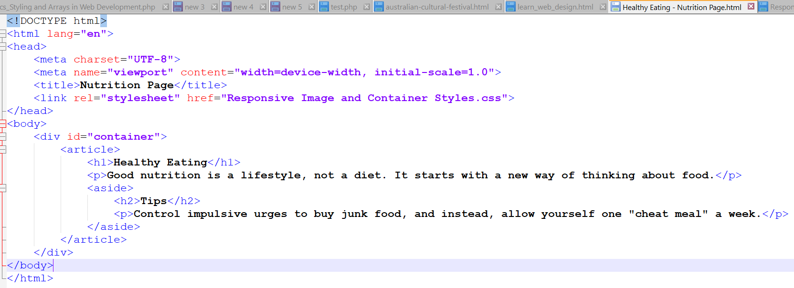
Weeks 8 – 9 Tutorial: Explicit example 1 covering lecture 7
<aside>:
In this HTML example, the <aside> element is used to provide supplementary information related to the main content of the <article>. The primary purpose of the <aside> is to house content that is indirectly related to the main topic but still relevant and useful. Here, the <aside> contains tips for healthy eating, which complement the main article about healthy eating habits.

Slide 5
Weeks 8 – 9 Tutorial: Explicit example 1 covering lecture 7
<aside>:
Contextual Information: It offers additional advice (tips) that enhances the reader's understanding and practice of healthy eating.
Separation of Content: It separates supplementary content from the main content.

Slide 6
Weeks 8 – 9 Tutorial: Explicit example 1 covering lecture 7
<aside>:
Represents content that is tangentially related to the content around it. Here, it is used to provide additional tips related to the main article content.

Slide 7
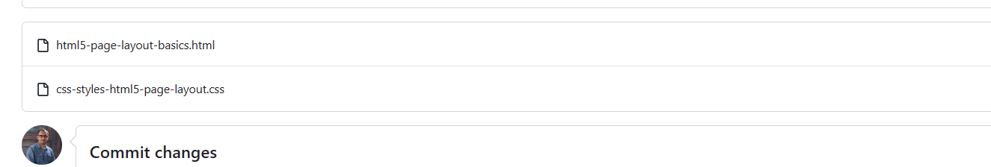
Weeks 8 – 9 Tutorial: 2. Explicit example 2 covering lecture 7
This example illustrates the use of semantic HTML5 elements, CSS properties for styling and layout, and responsive design techniques.

Slide 8
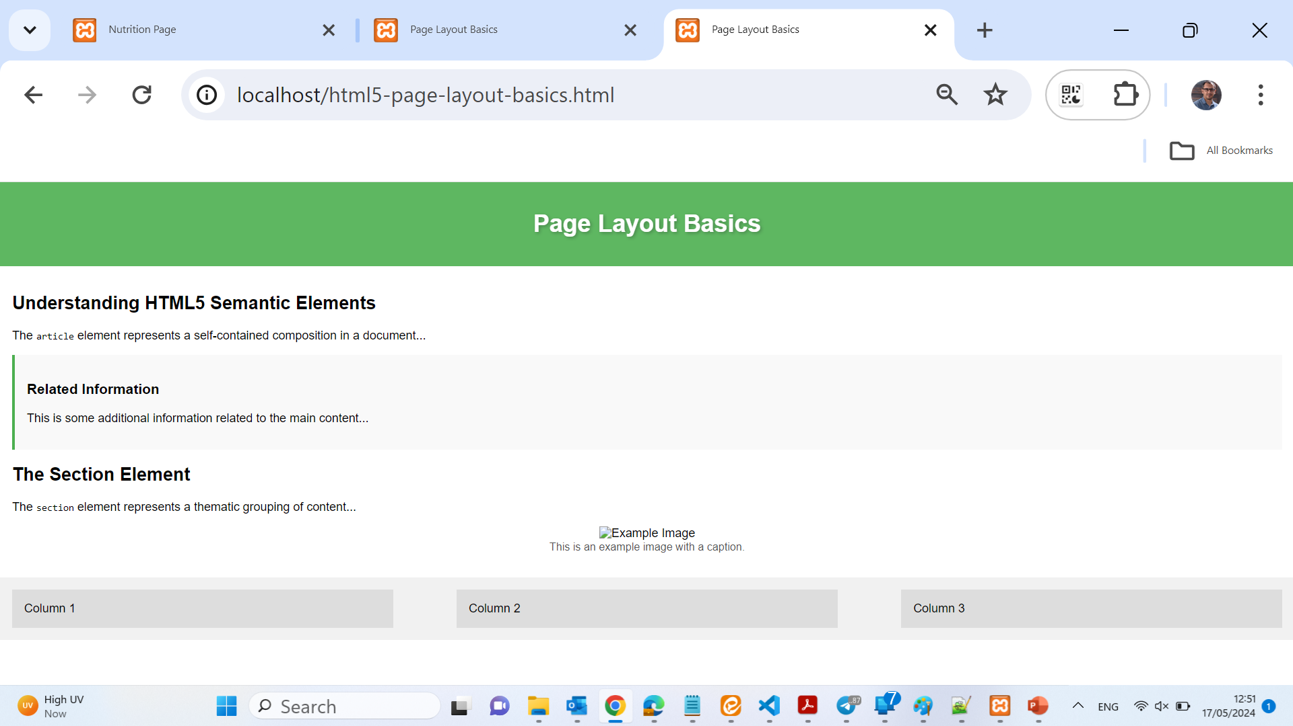
Weeks 8 – 9 Tutorial: 2. Explicit example 2 covering lecture 7

Slide 9
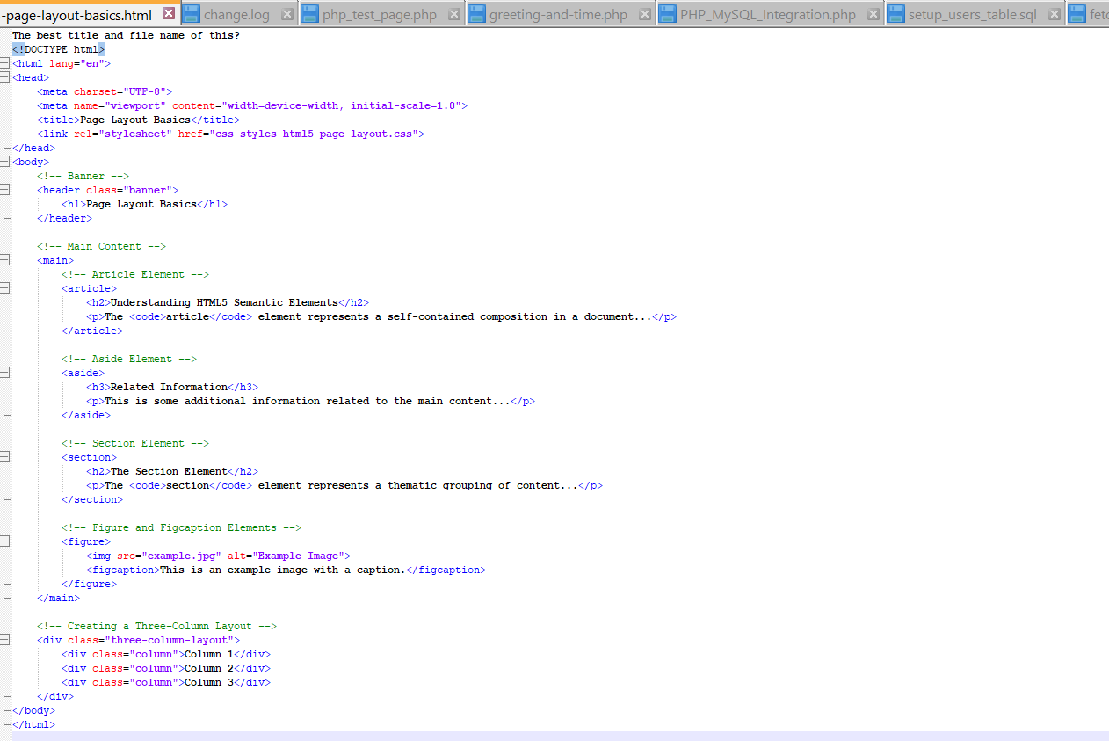
Weeks 8 – 9 Tutorial: 2. Explicit example 2 covering lecture 7
1. Banner: The `<header>` element with the class `banner` represents the banner of the website, displaying the site name.
2. Main Content: The `<main>` element contains:
Article: The `<article>` element represents a self-contained composition.
Aside: The `<aside>` element provides additional information related to the main content.
Section: The `<section>` element represents a thematic grouping of content.
Figure and Figcaption: The `<figure>` element groups an image (`<img>`) and its caption (`<figcaption>`).
3. Three-Column Layout: A `<div>` with the class `three-column-layout` creates a container for a three-column layout using flexbox.

Slide 10
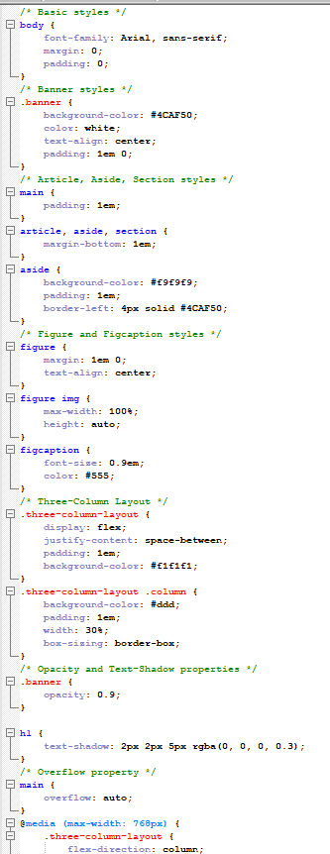
Weeks 8 – 9 Tutorial: 2. Explicit example 2 covering lecture 7
1. Basic styles: General styling for the `body` and resetting margins and padding.
2. Banner styles: Styling the banner with a background color, text color, and padding. The `opacity` property is used to set transparency.
3. Article, Aside, Section styles: Adding margins and padding to the `<main>` and its child elements. The `aside` element has additional styling for a distinct background and border.
4. Figure and Figcaption styles: Centering the figure and ensuring the image scales responsively. The `figcaption` is styled with a smaller font and color.
5. Three-Column Layout: Using flexbox to create a three-column layout. Each column is styled with a background color, padding, and width.
6. Opacity and Text-Shadow properties: Applying `opacity` to the banner and `text-shadow` to the `<h1>` for visual effects.
7. Overflow property: Ensuring the main content area scrolls if content overflows.
8. Responsive Design: Adjusting the three-column layout for smaller screens using a media query.

Slide 11
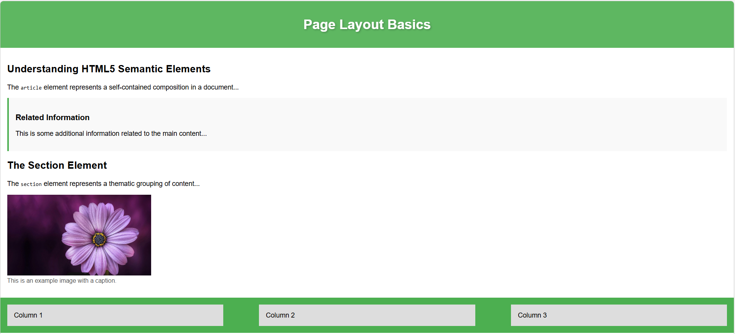
Weeks 8 – 9 Tutorial: 2. Explicit example 2 covering lecture 7
Add an image and change the background color in three-column-layout section:
.three-column-layout {
display: flex;
justify-content: space-between;
padding: 1em;
background-color: #4CAF50;
}

Slide 12
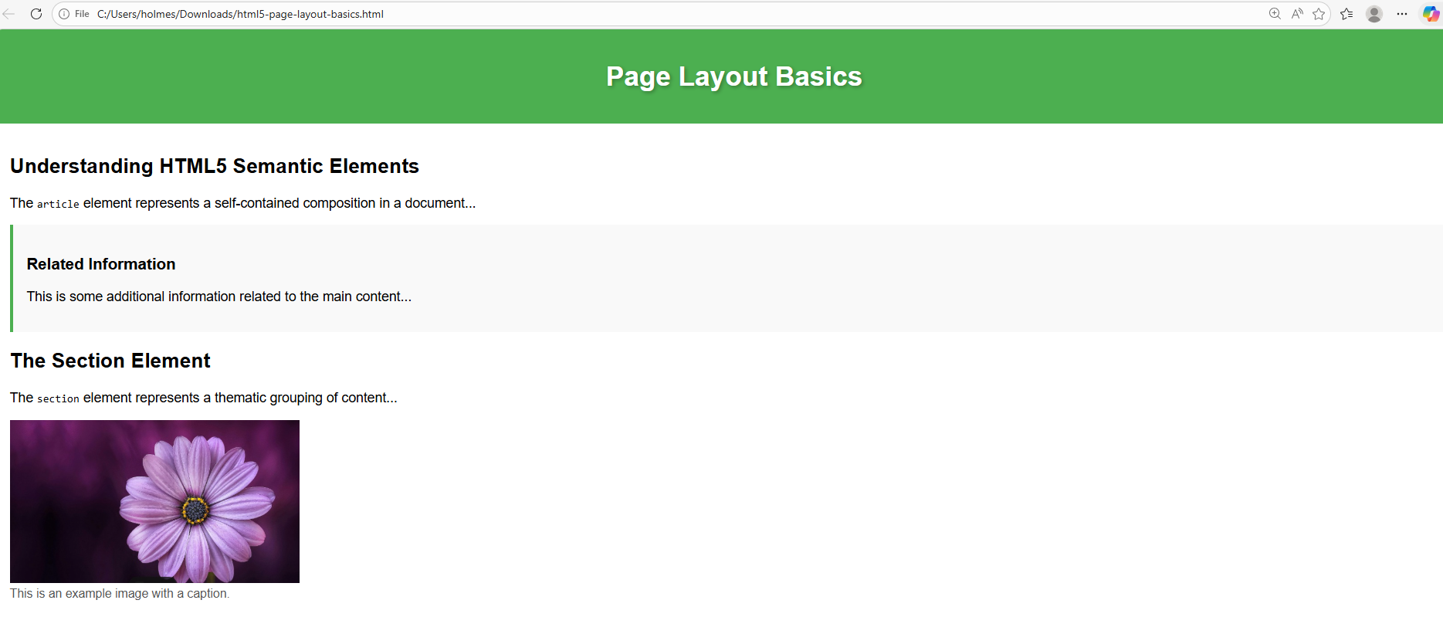
Weeks 8 – 9 Tutorial: 2. Explicit example 2 covering lecture 7
.banner {
opacity: 1.9;
}
Change Opacity of Banner

Slide 13
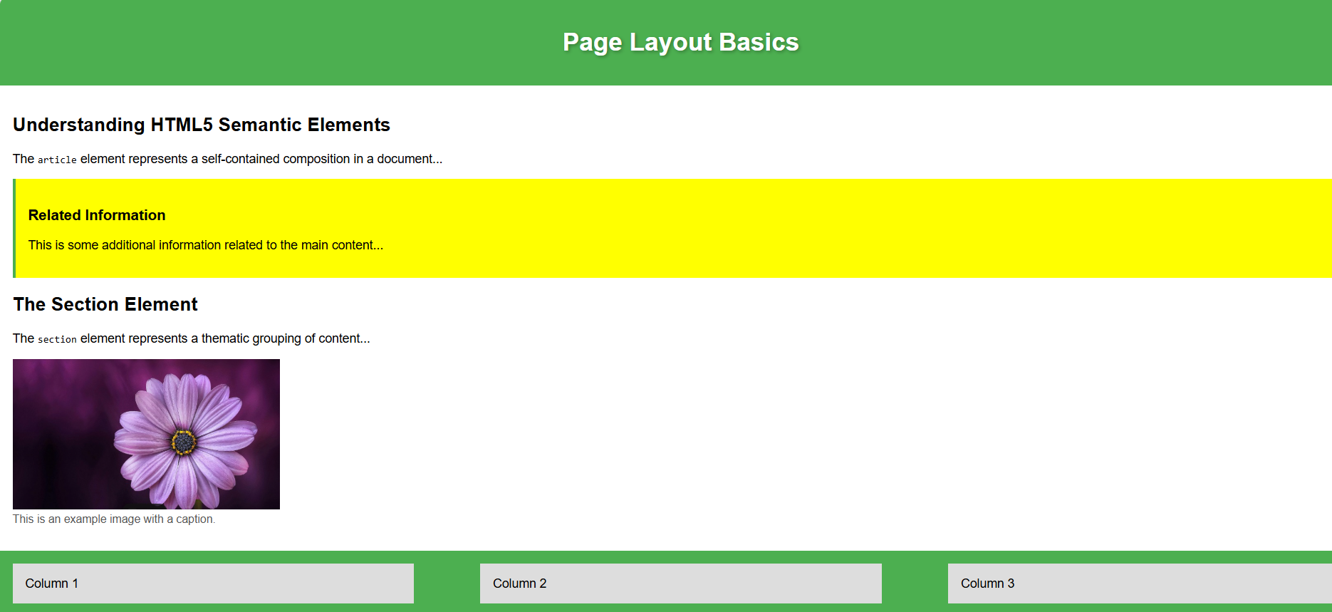
Weeks 8 – 9 Tutorial: 2. Explicit example 2 covering lecture 7
aside {
background-color: yellow;
padding: 1em;
border-left: 4px solid #4CAF50;
}
Change Background color in aside element

Slide 14
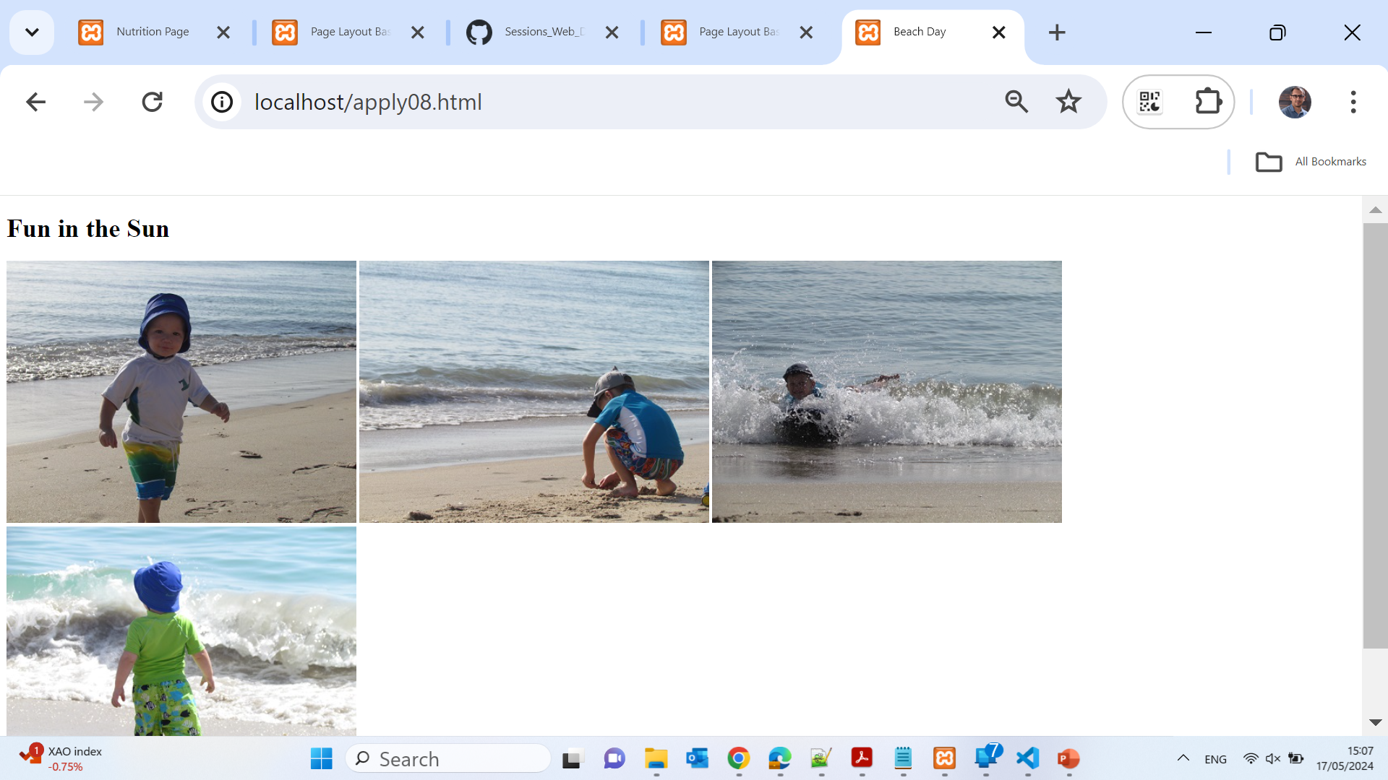
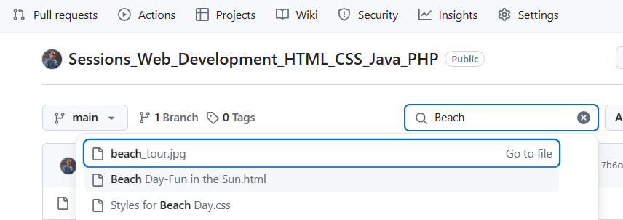
Weeks 8 – 9 Tutorial: 2. Project 1 Beach Day
Project 1: Styling for Responsive Design
Instructions:
Open apply08.html in your browser:
Done.
Open apply08.html in your text editor and modify the comment at the top:

Slide 15
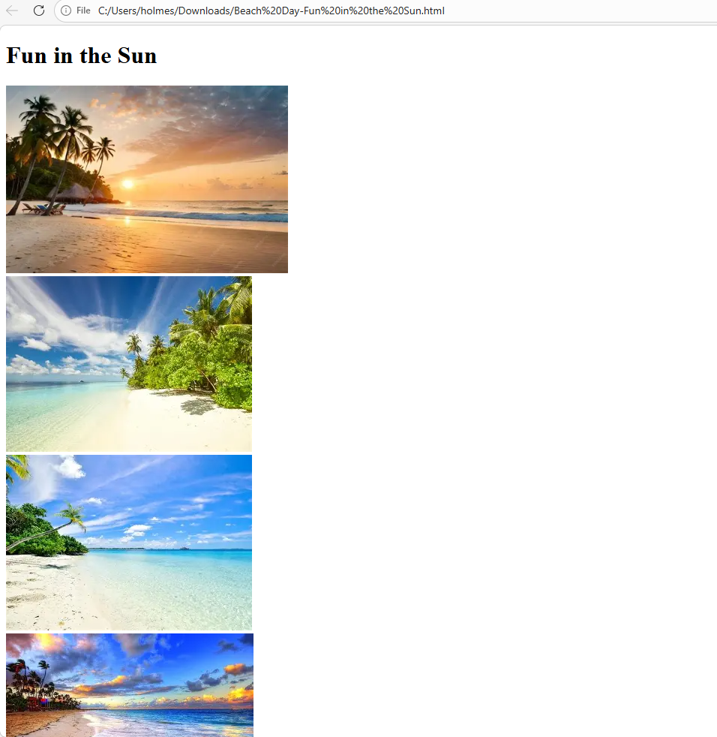
Weeks 8 – 9 Tutorial: 2. Project 1 Beach Day
Show the figure in a lower width (show images vertically) – with any beach images
/* Styles for Beach Day - Mayer Alvarez Vivanco, 2024-05-17 */
img {
max-width: 100%;
}
#container {
width: 20%;
}

Slide 16
Weeks 8 – 9 Tutorial: 2. Project 1 Beach Day
Project 1: Styling for Responsive Design
3. Remove the width and height attributes from the image elements and save your changes:
Done above.
4. Open styles08.css and modify the comment at the top:

Slide 17
Weeks 8 – 9 Tutorial: 2. Project 1 Beach Day
5. Add a max-width property with a value of 100% to the img selector:
Done above.
6. Change the width value of the #container selector to use a relative measurement:
Done above.
7. Save the styles08.css file and refresh the apply08.html file in your browser. Resize the browser to ensure the layout is fluid and images are flexible:
Done.
8. Add the following meta tag within the head section of the document:
Done above.

Slide 18
Weeks 8 – 9 Tutorial: 2. Project 1 Beach Day
9. Save your changes to apply08.html and open the file in Google Chrome:
Done.
10. Use the developer tools in Google Chrome to view the page in an emulator:
Done.
11. Select a device and refresh the page. The page should look similar to Figure 1:
Verified.

Slide 19
Weeks 8 – 9 Tutorial: 2. Project 1 Beach Day
12. Validate your HTML document using the W3C validator:
W3C Validator
13. Validate your CSS file using the W3C validator:
W3C CSS Validator
14. Submit the apply08.html and styles08.css files in a format specified by your instructor:
Done.
15. Explain how the percentage unit of measurement makes a fluid layout more flexible as compared to px:
Using percentages for width allows the layout to adapt to different screen sizes, making it more flexible and responsive. Unlike fixed pixel values, percentage values enable elements to scale relative to their container, providing a better user experience across various devices.

Slide 20
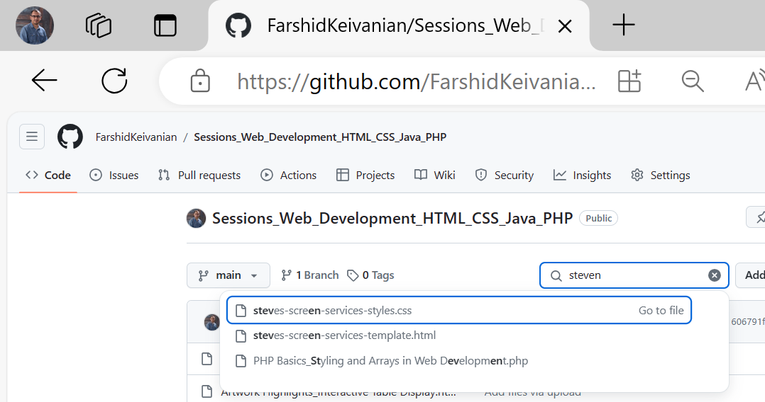
Weeks 8 – 9 Tutorial: 2. Challenge 1
Challenge 1: Creating a Responsive Website for Steve’s Screen Services
Instructions:
Open index.html and screenstyles.css in your text editor:
Done.
Modify the comment at the top of index.html:

Slide 21
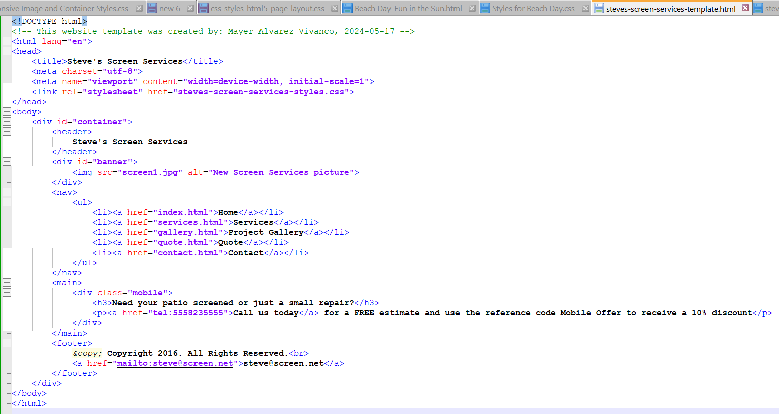
Weeks 8 – 9 Tutorial: 2. Challenge 1

Slide 22
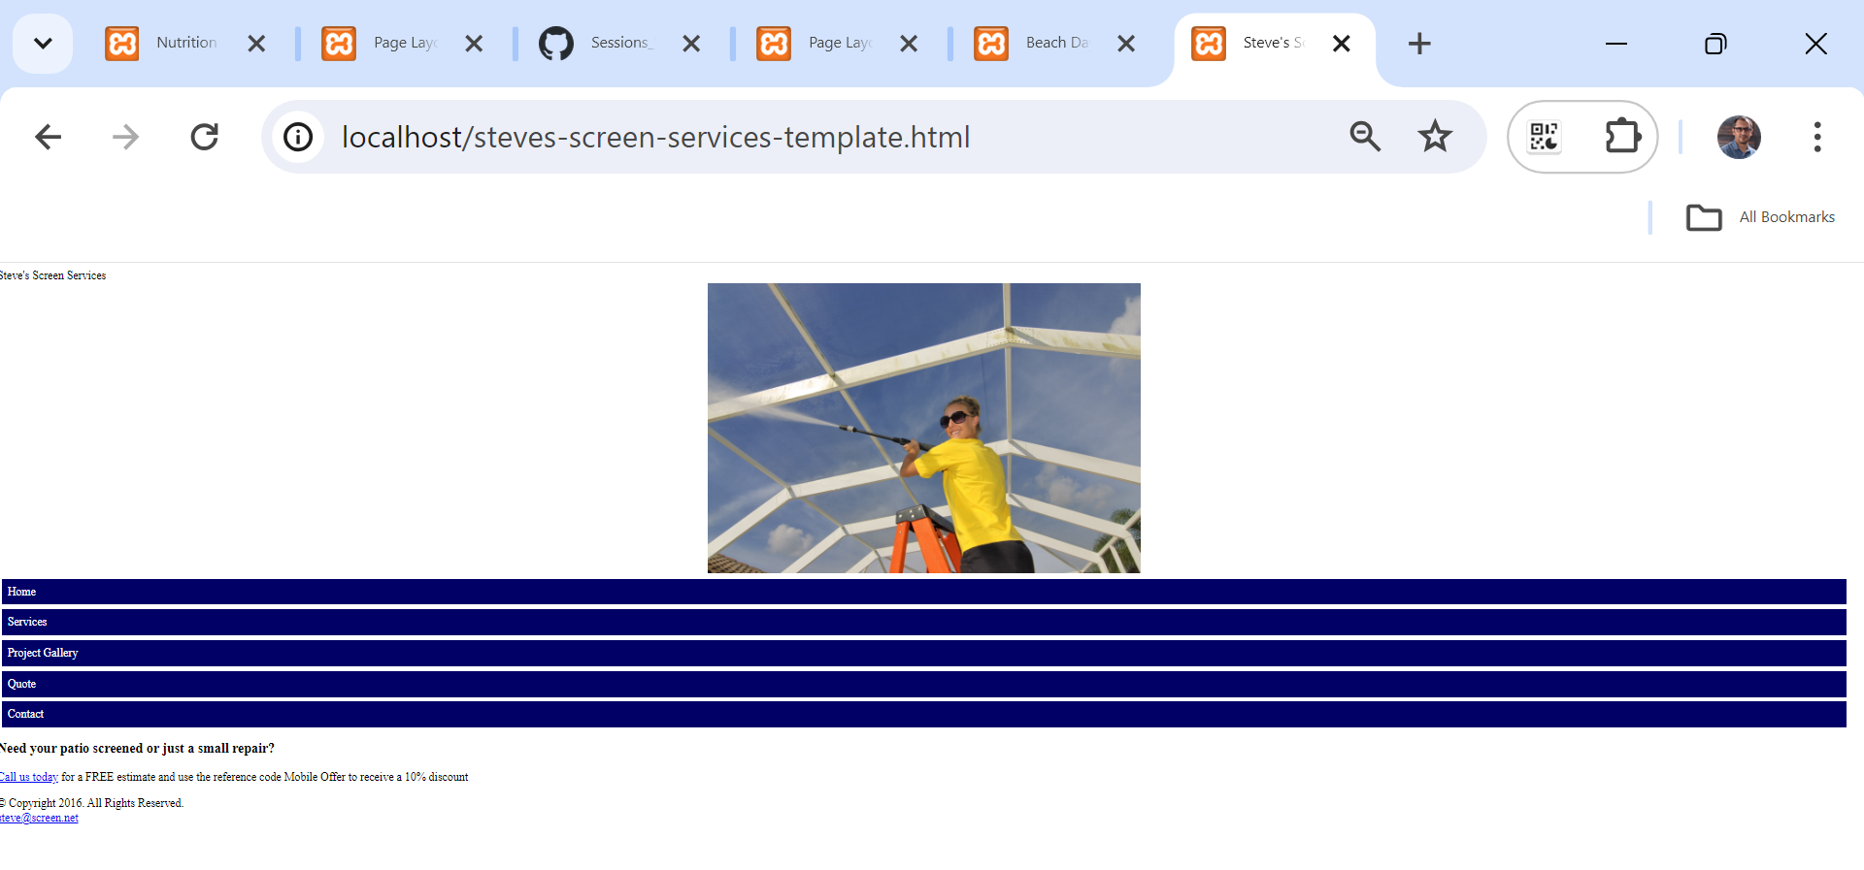
Weeks 8 – 9 Tutorial: 2. Challenge 1

Slide 23
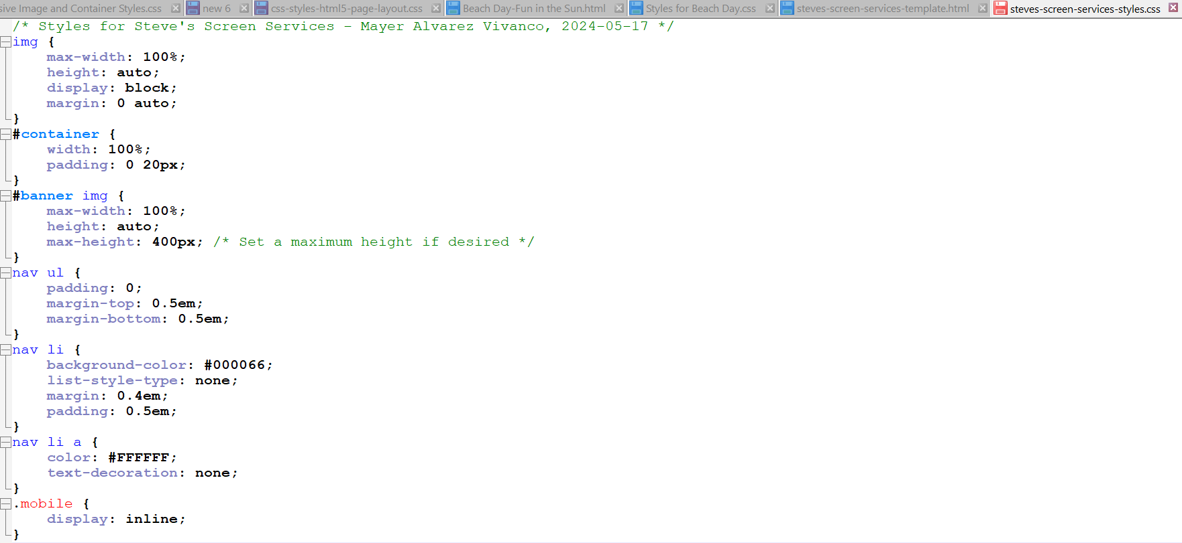
Weeks 8 – 9 Tutorial: 2. Challenge 1
3. Modify the comment at the top of screenstyles.css:

Slide 24
Weeks 8 – 9 Tutorial: 2. Challenge 1
4. Create a link to the external style sheet in index.html:
Done above.
5. Add the viewport meta tag to the head section:
Done above.
6. Delete the width and height attributes from all image elements:
Done above.

Slide 25
Weeks 8 – 9 Tutorial: 2. Challenge 1
7. Code each set of navigation links as an unordered list:
Done above.
8. Create a new div element with a class="mobile" and add the content:
Done above.
9. Add the style to make images flexible:
Done above.
10. Style the unordered list in the nav:
Done above.

Slide 26
Weeks 8 – 9 Tutorial: 2. Challenge 1
11. Style the list items within the nav:
Done above.
12. Style the nav links:
Done above.
13. Style the mobile class:
Done above.
14. Validate your HTML code:
W3C Validator

Slide 27
Weeks 8 – 9 Tutorial: 2. Challenge 1
15. Validate your CSS code:
W3C CSS Validator
16. Save all files and open the index.html page within a browser as shown in Figure 2:
Done.
17. Submit your assignment in the format specified by your instructor:
Done.
18. Research trends in navigation design for responsive web design:
Current trends include using mobile-first design, hamburger menus for compact navigation, sticky navigation bars for easy access, and responsive grids and flexbox layouts for better adaptability.
By following these steps, you will create a responsive design for both Project 1 and Challenge 1.

Slide 28
Multiple Choice Questions
Q1) What is the purpose of the aside element?
A) To group main content together
B) To create a sidebar with additional information
C) To define a section within a document
D) To apply styles to an image
Q2) Which property is used to manage content overflow in CSS?
A) float
B) overflow
C) opacity
D) text-shadow

Slide 29
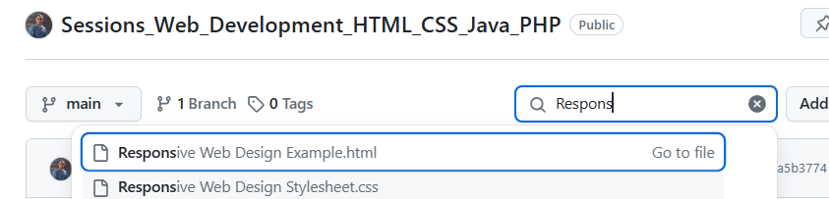
Weeks 8 – 9 Tutorial: Responsive Web Design Example
Objective: To create a responsive web page that covers all the key concepts from Lecture 8, including fluid layouts, flexible images, media queries, and the mobile-first strategy. ‘Responsive Web Design Example.html’ and ‘Responsive Web Design Stylesheet.css’
Example: Responsive Web Page

Slide 30
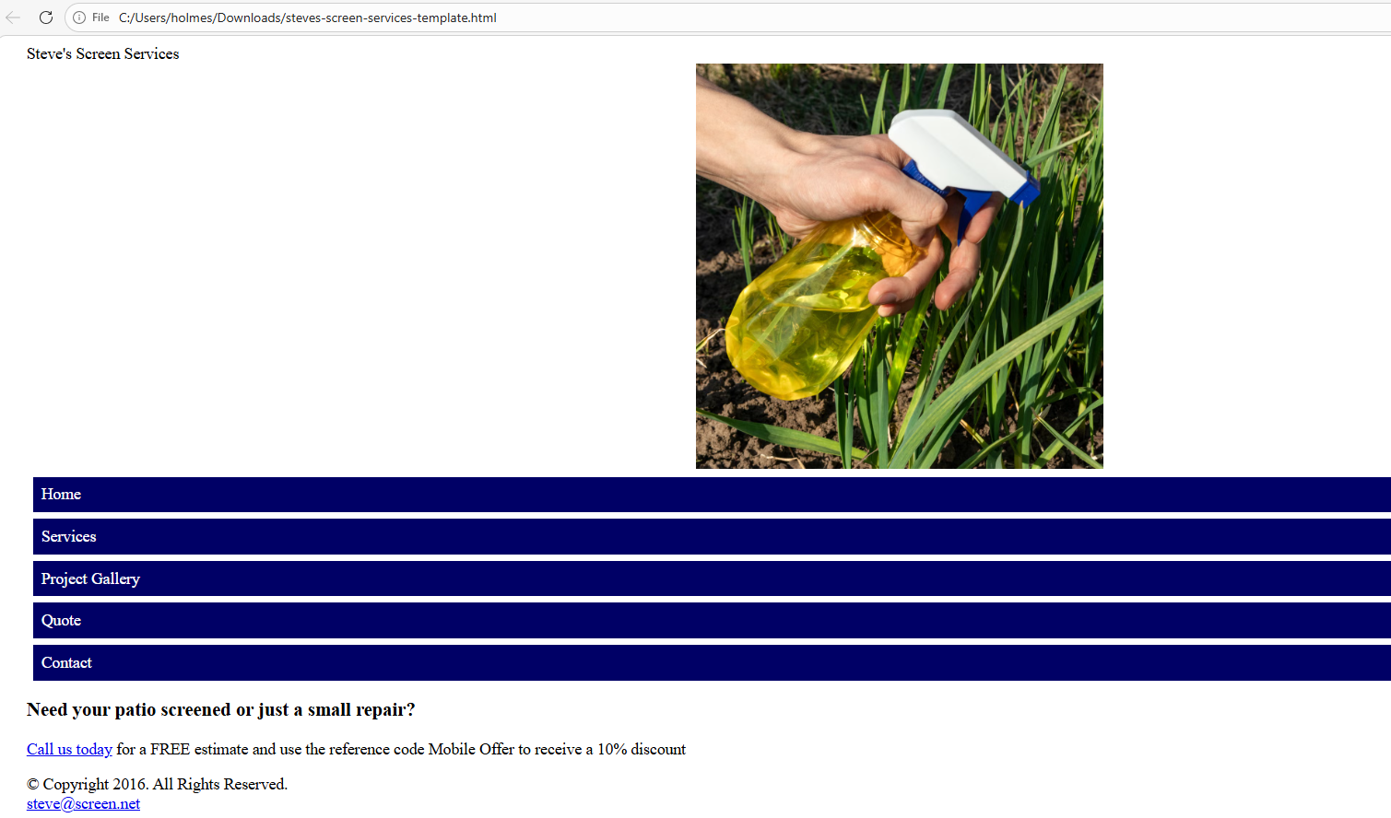
Weeks 8 – 9 Tutorial: Responsive Web Design Example
Use an image within the banner:
<div id="banner">
<img src="screen1.jpg" alt="New Screen Services picture">
</div>

Slide 31
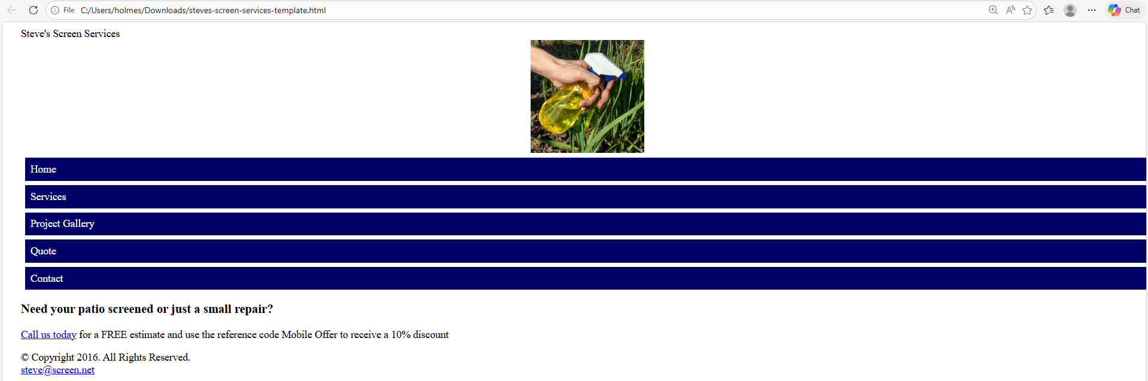
Weeks 8 – 9 Tutorial: Responsive Web Design Example
Reduce the max-width for the image
#banner img {
max-width: 10%;
height: auto;
max-height: 400px; /* Set a maximum height if desired */
}

Slide 32
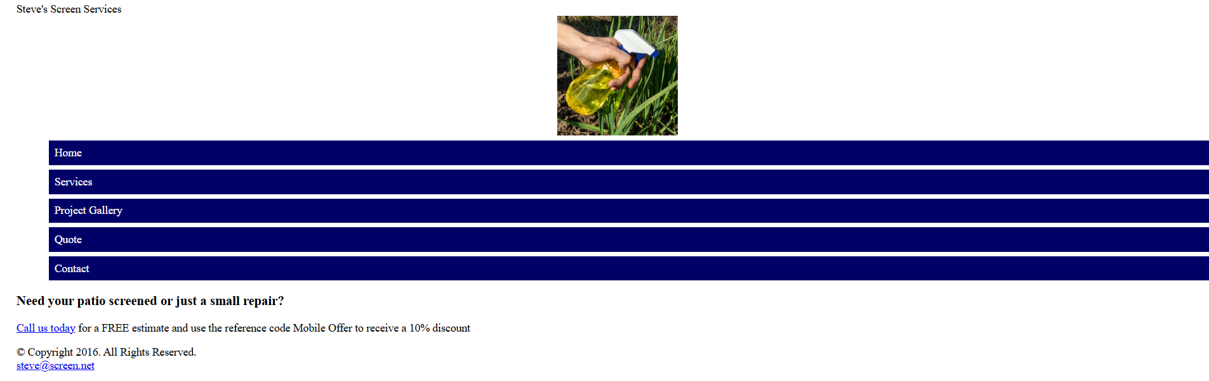
Weeks 8 – 9 Tutorial: Responsive Web Design Example
Increase the Padding
nav ul {
padding: 20;
margin-top: 0.5em;
margin-bottom: 0.5em;
}

Slide 33
Weeks 8 – 9 Tutorial: Responsive Web Design Example
<!DOCTYPE html>
<html lang="en">
This line declares the document type as HTML5 and sets the language of the document to English.

Slide 34
Weeks 8 – 9 Tutorial: Responsive Web Design Example
<head>
<meta charset="UTF-8">
<meta name="viewport" content="width=device-width, initial-scale=1">
<title>Responsive Web Design Example</title>
<link rel="stylesheet" href="Responsive Web Design Stylesheet.css">
</head>
<head>: Contains metadata and links to resources.
<meta charset="UTF-8">: Sets the character encoding to UTF-8.
<meta name="viewport" content="width=device-width, initial-scale=1">: Ensures proper scaling on mobile devices.
<title>Responsive Web Design Example</title>: Sets the title of the web page, which appears in the browser tab.
<link rel="stylesheet" href="styles.css">: Links to an external CSS file for styling the page.

Slide 35
<body>
<header>
<h1>Responsive Design Example</h1>
<nav>
<ul>
<li><a href="#">Home</a></li>
<li><a href="#">About</a></li>
<li><a href="#">Services</a></li>
<li><a href="#">Contact</a></li>
</ul>
</nav>
</header>
<header>: Defines the header section of the page.
<h1>Responsive Design Example</h1>: Main heading of the page.
<nav>: Defines a navigation menu.
<ul>: Unordered list to hold navigation links.
<li><a href="#">Link</a></li>: List items containing links (e.g., Home, About, Services, Contact).

Slide 36
<main>
<section>
<h2>Introduction to Responsive Design</h2>
<p>This example demonstrates the principles of responsive design, including fluid layouts, flexible images, and media queries.</p>
<img src="img.jpg" alt="Example Image">
</section>
</main>
<main>: Main content area of the page.
<section>: Defines a section within the main content.
<h2>Introduction to Responsive Design</h2>: Subheading for the section.
<p>This example demonstrates...media queries.</p>: Paragraph explaining the purpose of the example.
<img src= "img.jpg" alt="Example Image">: Image with a source file and alternative text.

Slide 37
Weeks 8 – 9 Tutorial: Responsive Web Design Example
<footer>
<p>Designed by: Dr. Farshid Keivanian</p>
</footer>
</body>
</html>
<footer>: Defines the footer section of the page.
<p>Designed by: Dr. Farshid Keivanian</p>: Paragraph crediting the designer.
</body>: Closing tag for the body.
</html>: Closing tag for the HTML document.
This HTML structure outlines a basic responsive web design example, including a header with navigation, main content with a section explaining responsive design, and a footer crediting the designer.

Slide 38
Weeks 8 – 9 Tutorial: Responsive Web Design Example
/* Style sheet created by: Dr. Farshid Keivanian, 23 May 2024 */
A comment indicating the author of the stylesheet and the date it was created. Comments in CSS are enclosed in /* */.

Slide 39
Weeks 8 – 9 Tutorial: Responsive Web Design Example
/* Style for body specifies a background color */
body {
background-color: #f0f0f0;
font-family: Arial, sans-serif;
margin: 0;
padding: 0;
}
This block sets the styles for the <body> element:
background-color: #f0f0f0;: Sets the background color to a light gray.
font-family: Arial, sans-serif;: Sets the font family to Arial, with a fallback to sans-serif.
margin: 0;: Removes the default margin.
padding: 0;: Removes the default padding.

Slide 40
Weeks 8 – 9 Tutorial: Responsive Web Design Example
nav ul {
list-style-type: none;
padding: 0;
}
This block sets the styles for the <ul> element inside <nav>:
list-style-type: none;: Removes the default bullet points from the list.
padding: 0;: Removes the default padding.

Slide 41
Weeks 8 – 9 Tutorial: Responsive Web Design Example
nav ul li {
display: inline;
margin: 0 1em;
}
This block sets the styles for the <li> elements inside <nav> <ul>:
display: inline;: Displays the list items horizontally.
margin: 0 1em;: Adds horizontal spacing between the list items.

Slide 42
Weeks 8 – 9 Tutorial: Responsive Web Design Example
nav ul li a {
color: white;
text-decoration: none;
}
This block sets the styles for the <a> elements inside <nav> <ul> <li>:
color: white;: Sets the text color to white.
text-decoration: none;: Removes the underline from the links.

Slide 43
Weeks 8 – 9 Tutorial: Responsive Web Design Example
/* Fluid layout for main content */
main {
margin: 2em auto;
max-width: 800px;
padding: 1em;
}
This block sets the styles for the <main> element:
margin: 2em auto;: Adds vertical margins and centers the main content horizontally.
max-width: 800px;: Limits the width of the main content to 800 pixels.
padding: 1em;: Adds padding inside the main content area.

Slide 44
Weeks 8 – 9 Tutorial: Responsive Web Design Example
main img {
max-width: 100%;
height: auto;
}
This block sets the styles for the <img> elements inside <main>:
max-width: 100%;: Ensures the images do not exceed the width of their container.
height: auto;: Maintains the aspect ratio of the images.

Slide 45
Weeks 8 – 9 Tutorial: Responsive Web Design Example
/* Responsive styles */
@media only screen and (max-width: 600px) {
header, nav ul li {
display: block;
text-align: center;
}
}
This block sets responsive styles for screens with a maximum width of 600 pixels:
@media only screen and (max-width: 600px): Media query targeting screens with a width of 600 pixels or less.
header, nav ul li { display: block; text-align: center; }: Changes the display property to block and centers the text for the <header> and <li> elements inside <nav> <ul> to ensure better readability on small screens.
This stylesheet provides a simple but effective set of styles for creating a responsive web design.

Slide 46
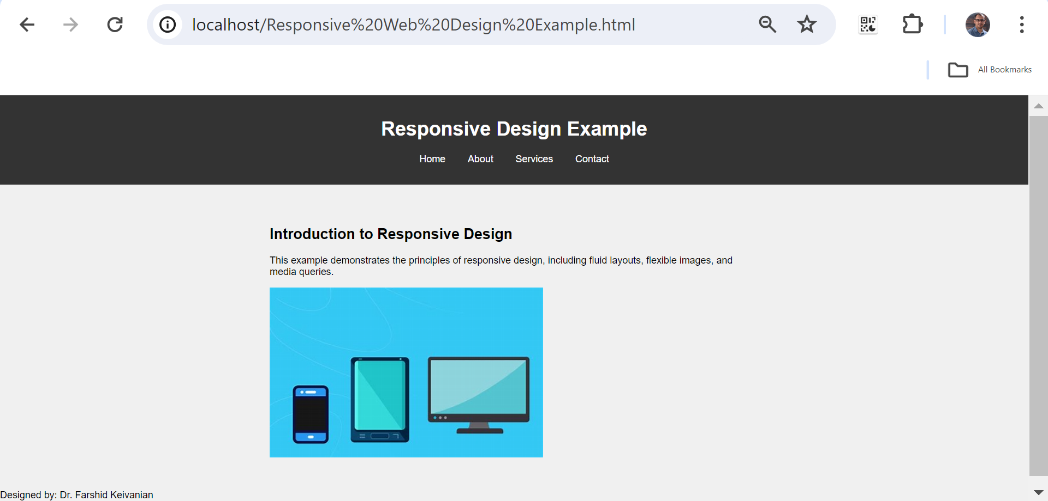
Weeks 8 – 9 Tutorial: Responsive Web Design Example

Slide 47
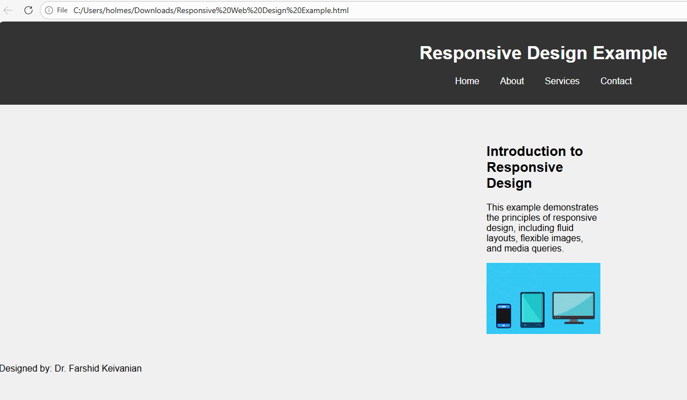
Weeks 8 – 9 Tutorial: Responsive Web Design Example
Reduce the max-width for the main section
main {
margin: 2em auto;
max-width: 200px;
padding: 1em;
}

Slide 48
Weeks 8 – 9 Tutorial: Responsive Web Design Example
Change text alignment from center to left
/* Responsive styles */
@media only screen and (max-width: 600px) {
header, nav ul li {
display: block;
text-align: center;
}
}

Slide 49
Weeks 8 – 9 Tutorial: Project 2
Project 2: Using Tables
Open apply09.html in your text editor:
Add a title: 2017 Sales by Quarter
Modify the comment at the top:
<!-- This website template was created by: Mayer Alvarez Vivanco, Today's Date -->
Replace “Student’s Name” with “Mayer Alvarez Vivanco” in the footer:
<footer>
<p>Designed by: Mayer Alvarez Vivanco</p>
</footer>

Slide 50
Weeks 8 – 9 Tutorial: Project 2
2. Open applystyles09.css and modify the comment at the top:
/* Style sheet created by: Mayer Alvarez Vivanco, Today's Date */

Slide 51
3. In apply09.html, add a table element within the main element:
<main>
<table>
<caption>2017 Sales by Quarter</caption>
<tr>
<th>Product</th>
<th>Quarter 1</th>
<th>Quarter 2</th>
<th>Quarter 3</th>
<th>Quarter 4</th>
</tr>
<tr>
<th>Tablets</th>
<td>&#36;24,500</td>
<td>&#36;21,525</td>
<td>&#36;20,217</td>
<td>&#36;28,575</td>
</tr>
<tr>
<th>Monitors</th>
<td>&#36;12,825</td>
<td>&#36;12,400</td>
<td>&#36;11,900</td>
<td>&#36;14,233</td>
</tr>
<tr>
<th>Laptops</th>
<td>&#36;33,000</td>
<td>&#36;32,750</td>
<td>&#36;31,595</td>
<td>&#36;32,465</td>
</tr>
<tr>
<th>Desktops</th>
<td>&#36;21,478</td>
<td>&#36;20,895</td>
<td>&#36;18,200</td>
<td>&#36;21,625</td>
</tr>
</table>
</main>

Slide 52
4. In applystyles09.css, create the following style rules:
/* Style for table */
table {
width: 80%;
margin-left: auto;
margin-right: auto;
}
/* Style for table, tr, th, td */
table, tr, th, td {
border-collapse: collapse;
border: solid 0.1em #000000;
padding: 1em;
}
/* Style for table data */
td {
text-align: center;
}
/* Style for table caption */
caption {
font-size: 2em;
padding: 1em;
margin-top: 1em;
}

Slide 53
5. Validate HTML and CSS files using W3C validator:
Use the W3C validator found at validator.w3.org for HTML.
Use the W3C validator found at jigsaw.w3.org/css-validator for CSS.

Slide 54
6. Describe the purpose of using the table header elements:
Purpose: The table header elements (<th>) are used to define header cells in the table, which are typically rendered in bold and centered by default. They provide a semantic meaning, indicating that the cells contain header information.
Styling: To left-align the text in table header elements
th {
text-align: left;
}

Slide 55
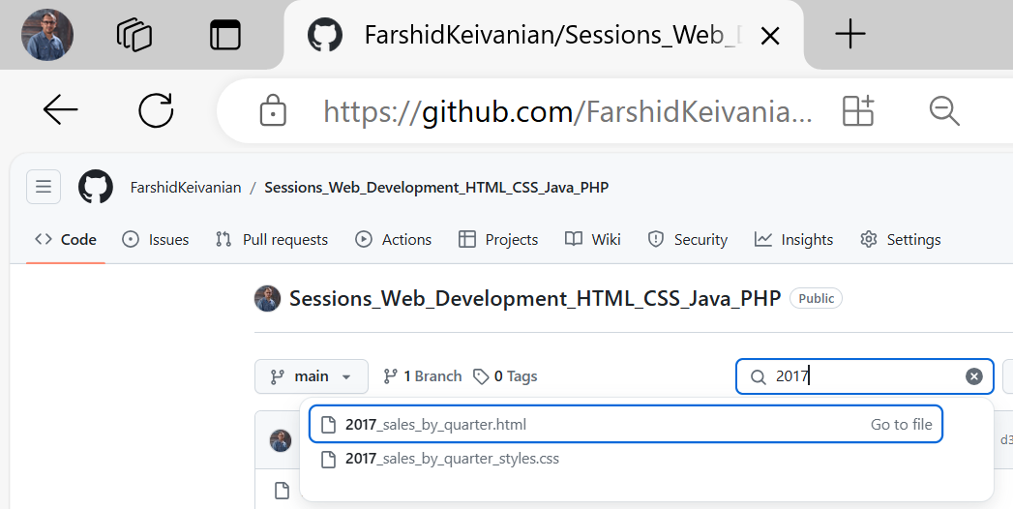
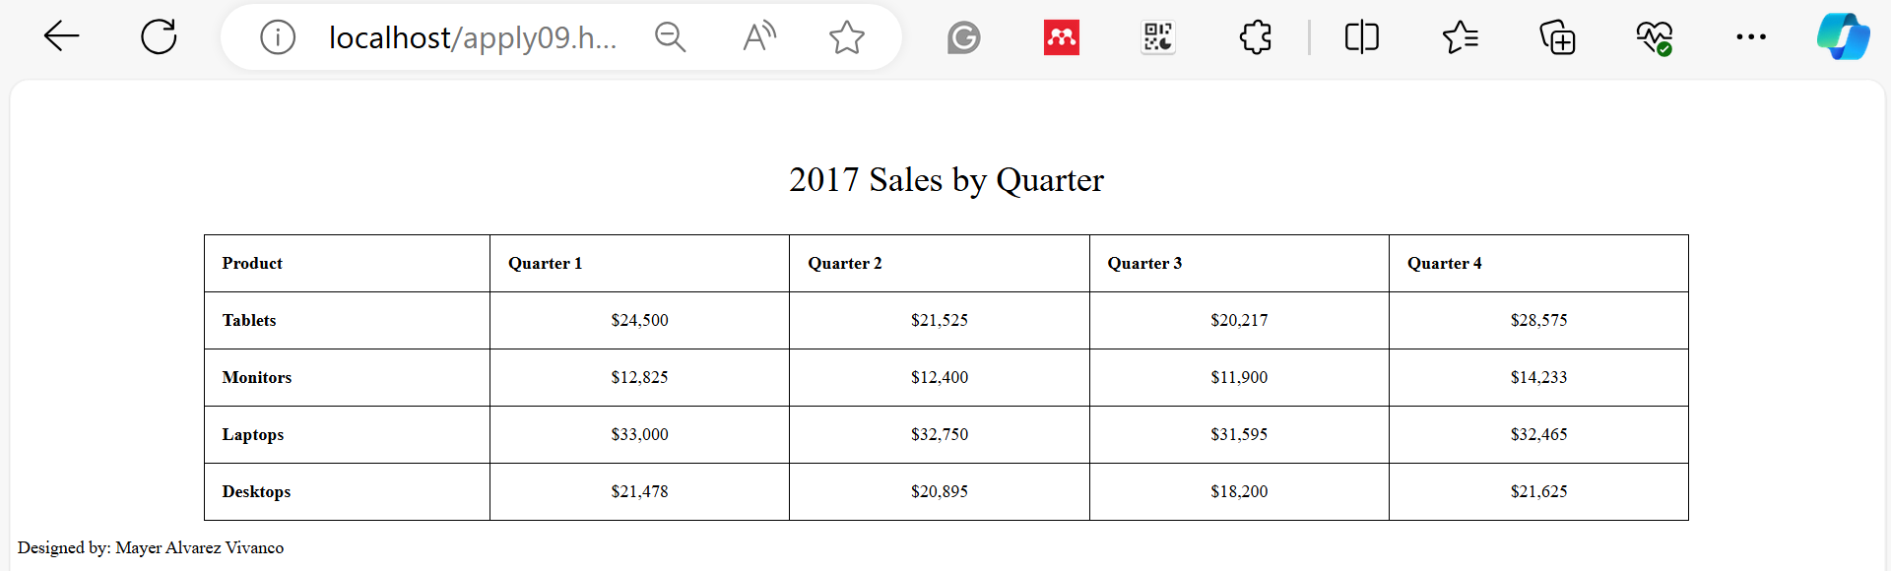

Slide 56
Weeks 8 – 9 Tutorial: Challenge 2 - Working with Form Elements
1. Open form09.html in your text editor:
Add a title: User Registration Form
Link to styles09.cs
<link rel="stylesheet" href="styles09.css">

Slide 57
Weeks 8 – 9 Tutorial: Challenge 2 - Working with Form Elements
Modify the comment at the top
<!-- This website template was created by: Mayer Alvarez Vivanco, Today's Date -->

Slide 58
Weeks 8 – 9 Tutorial: Challenge 2 - Working with Form Elements
Replace “Student’s Name” with “Mayer Alvarez Vivanco” in the footer
<footer>
<p>Designed by: Mayer Alvarez Vivanco</p>
</footer>

Slide 59
Weeks 8 – 9 Tutorial: Challenge 2 - Working with Form Elements
2. Create the form within the main element:
<main>
<form action="submit_form.php" method="post">
<label for="username">Username:</label>
<input type="text" id="username" name="username" required>
<label for="password">Password:</label>
<input type="password" id="password" name="password" required>
<label for="dob">Date of Birth:</label>
<input type="date" id="dob" name="dob" required>
<p>Upload your file here</p>
<input type="file" name="file" size="20">
<p>Example of Radio Buttons</p>
<input type="radio" id="option1" name="option" value="1">
<label for="option1">Option 1</label>
<input type="radio" id="option2" name="option" value="2">
<label for="option2">Option 2</label>
<input type="radio" id="option3" name="option" value="3">
<label for="option3">Option 3</label>
</form>
</main>

Slide 60
Weeks 8 – 9 Tutorial: Challenge 2 - Working with Form Elements
3. In styles09.css, create style rules for form elements:
/* Style for form elements */
form {
width: 50%;
margin: auto;
padding: 1em;
background-color: #f9f9f9;
border: 1px solid #ccc;
}
form label {
display: block;
margin-top: 1em;
}
form input[type="text"], form input[type="password"], form input[type="date"], form input[type="file"] {
width: 100%;
padding: 0.5em;
margin-top: 0.5em;
}
form p {
margin-top: 1em;
font-weight: bold;
}

Slide 61
Weeks 8 – 9 Tutorial: Challenge 2 - Working with Form Elements
4. Describe the difference in how the date type input field displays in Firefox and Google Chrome:
Firefox: The date input field is displayed as a regular text box where users must manually enter the date in the specified format.
Google Chrome: The date input field includes a date picker, allowing users to select a date from a calendar widget.
By following these instructions, you will learn to create and style tables and forms in HTML and CSS, enhancing your understanding of web development practices and preparing yourself for your tutorial week 9.

Slide 62
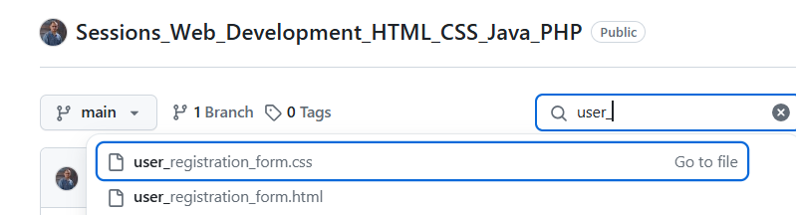
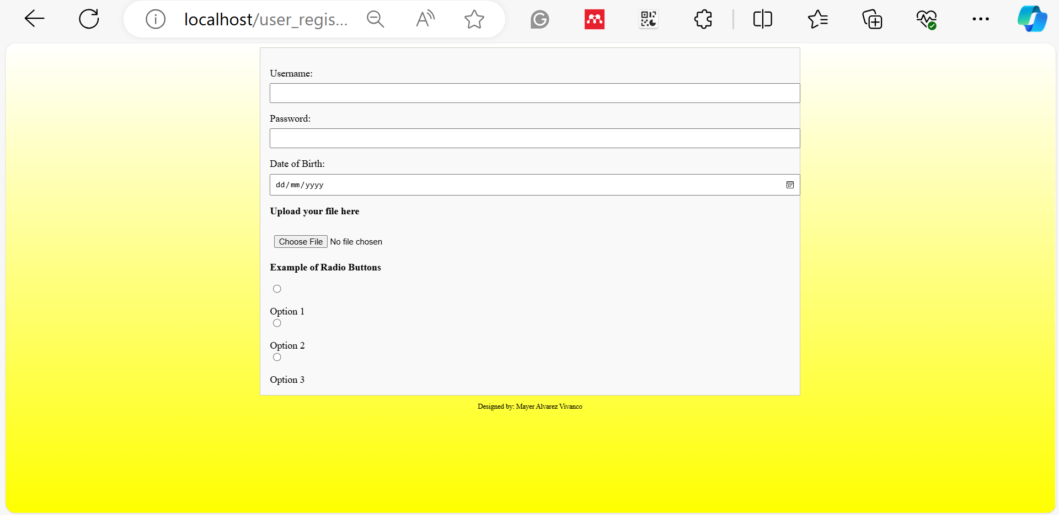
Weeks 8 – 9 Tutorial: Challenge 2 - Working with Form Elements

Slide 63
Multiple Choice Question
Q1) What are the three main concepts of responsive design discussed in Lecture 8?
A. Fixed layouts, fluid layouts, and flexible images
B. Fluid layouts, media queries, and flexible images
C. Media queries, viewport tags, and mobile-first strategy
D. Flexible images, fixed layouts, and media queries

Slide 64
Multiple Choice Question
Q2) Which of the following statements correctly describes a fluid layout in responsive web design?
A. It uses fixed measurement units like pixels to define the width of content areas.
B. It changes in width based on the size of the viewport, using proportional size measurements.
C. It requires media queries to adjust content size based on the viewport.
D. It is the same as a fixed layout but with flexible images.

Slide 65
Lab 4 Practice
1. Which file should you open first to view the webpage in Project 1?
Options:
A. apply08.html
B. apply09.html
C. index.html
D. form09.html
The project instructions start with apply08.html, so this is the first file you open to see and work on the webpage.

Slide 66
Lab 4 Practice
2. What information should be added to the comment section at the top of apply08.html?
Options:
A. Your name and today’s date
B. Your student ID only
C. Your instructor’s name
D. A link to the CSS file
Adding your name and the current date shows who completed the work and when it was completed.

Slide 67
Lab 4 Practice
3. What should be removed from all image elements in apply08.html?
Options:
A. Width and height attributes
B. Alt attributes
C. Title attributes
D. Borders
Removing fixed width and height values allows images to resize automatically on different screen sizes, making the page responsive.

Slide 68
Lab 4 Practice
4. What CSS rule should be added to the img selector in styles08.css?
Options:
A. max-width: 100%;
B. width: auto;
C. height: 50%;
D. border-radius: 10px;
This rule prevents images from becoming wider than their container, helping them fit properly on mobile and desktop screens.

Slide 69
Lab 4 Practice
5. What change should be made to the #container selector in Project 1?
Options:
A. Set width to a relative measurement
B. Add a fixed width
C. Remove background color
D. Add padding only
Relative measurements (such as percentages) allow the layout to adjust to different screen sizes more easily.

Slide 70
Lab 4 Practice
6. Which meta tag should be added for responsive web design in apply08.html?
Options:
A. <meta name="viewport" content="width=device-width, initial-scale=1">
B. <meta name="viewport" content="width=device-width, initial-scale=3">
C. <p><a href="tel:5558235555">Call us today</a>
D. <h3>Need your patio screened or just a small repair?</h3>
This viewport tag tells browsers to display the webpage correctly on mobile devices by matching the screen width.

Slide 71
Lab 4 Practice
7. Which browser tool should be used to test the webpage in mobile view?
Options:
A. Chrome Developer Tools emulator
B. Firefox Add-ons
C. Safari’s Web Inspector
D. Edge Performance Tools
Chrome Developer Tools includes a device emulator that lets you see how a webpage looks on phones and tablets.

Slide 72
Lab 4 Practice
8. Which unit makes a layout more flexible than pixels (px) in Project 1?
Options:
A. Percentage (%)
B. Rem units
C. Pixels
D. Centimeters
Percentages adjust based on the size of the screen or container, making layouts more responsive than fixed pixel values.

Slide 73
Lab 4 Practice
9. What text should the <title> element contain in Challenge 1?
Options:
A. Steve’s Screen Services
B. Screen Repair Specialists
C. Responsive Web Design
D. Steve’s Patio Repair
The title element should contain the website’s name so it appears correctly in the browser tab and search results.

Slide 74
Lab 4 Practice
10. How should the navigation links be coded in index.html?
Options:
A. As an unordered list
B. As a navigation table
C. As paragraph elements
D. As a list of spans
Navigation menus are commonly built using unordered lists (<ul> and <li>), which provide a clear and organized structure for links.

Slide 75
Lab 4 Practice
11. Which new class should be added to a <div> element inside the <main> section?
A. mobile
B. flex
C. container
D. sidebar
The mobile class is added to help display content properly on mobile devices and support responsive design.

Slide 76
Lab 4 Practice
12. Which CSS property should be added to images in screenstyles.css to make them flexible?
A. max-width: 100%;
B. min-width: 50%;
C. height: auto;
D. display: block;
This property makes images shrink when needed so they fit inside their container without overflowing.

Slide 77
Lab 4 Practice
13. What background color is used for the navigation list items (nav li)?
Options:
A. #000066
B. #FFFFFF
C. #f15a24
D. #183440
The navigation items use the dark blue color #000066 as their background.

Slide 78
Lab 4 Practice
14. What text color should be used for navigation links?
A. White (#FFFFFF)
B. Black (#000000)
C. Green (#00FF00)
D. Blue (#0000FF)
White text creates a strong contrast against the dark blue navigation background, making links easy to read.

Slide 79
Lab 4 Practice
15. What display value is assigned to the .mobile class?
A. inline
B. block
C. flex
D. grid
The inline display value allows the element to appear within the same line as surrounding content.

Slide 80
Lab 4 Practice
16. Which file should be edited in Project 2 to add a table?
Options:
A. apply09.html
B. apply08.html
C. index.html
D. form09.html
Project 2 instructions require adding the table to apply09.html, so that is the file that must be edited.

Slide 81
Lab 4 Practice
17. What width should be assigned to the table in applystyles09.css?
A. 80%
B. 100%
C. 60%
D. auto
Setting the table width to 80% gives it a balanced size while leaving space on both sides.

Slide 82
Lab 4 Practice
18. Which CSS code centers the table on the page?
A. margin-left: auto; and margin-right: auto;
B. text-align: center;
C. display: inline-block;
D. float: none;
Using automatic left and right margins centers the table horizontally within its container.

Slide 83
Lab 4 Practice
19. What should be added first inside the <table> element?
A. 2017 Sales by Quarter
B. Sales
C. A <tag>
D. A summary attribute
This text is used as the table caption or title, helping users understand the table’s purpose.

Slide 84
Lab 4 Practice
20. Which product is listed first in the quarterly sales table?
A. Tablets
B. Monitors
C. Desktops
D. Laptops
The first row of product data in the table is Tablets.

Slide 85
Lab 4 Practice
21. Which table text should be centered according to the CSS rules?
A. td text
B. th text
C. caption text
D. footer text
The CSS rule centers the text inside table data cells (td), making the data easier to read.

Slide 86
Lab 4 Practice
22. What font size should be used for the table caption?
A. 2em
B. 1em
C. 3em
D. 14px
A font size of 2em makes the caption larger than normal text, helping it stand out as the table title.

Slide 87
Lab 4 Practice
23. In the form09.html activity, which input type should be used for a Date of Birth field?
A. date
B. text
C. time
D. datetime-local
The date input type provides a built-in calendar picker, making it easy for users to select their birth date correctly.

Slide 88
Lab 4 Practice
24. Which attribute should be added to the file input field in the form exercise?
Options:
A. size="20"
B. value="20"
C. width="20"
D. data-size="20"
The size attribute controls the visible width of the file input box, making it easier for users to see selected file names.

Slide 89
Lab 4 Practice
25. What comparison must be discussed in the final written task?
Options:
A. How the date input appears in Firefox versus Google Chrome
B. How radio buttons appear on mobile versus desktop
C. How CSS validation works across browsers
D. How table headers display in Safari
Different browsers may display date input fields differently. The task requires observing and explaining these differences between Firefox and Google Chrome.

Slide 90

Let’s Answer Your Questions
Live during class – Ask directly during sessions.
Blackboard Inbox – For structured academic queries.
Email – For formal communications or attachments.
Discussion Forum – Everyone can see and learn from your question.

Slide 91

Thank You
Happy Learning and Bright Futures Ahead!
Stay Connected: linkedin.com/in/farshid-keivanian github.com/FarshidKeivanian
Education is the most powerful weapon you can use to change the world. — Nelson Mandela

